Slide 1
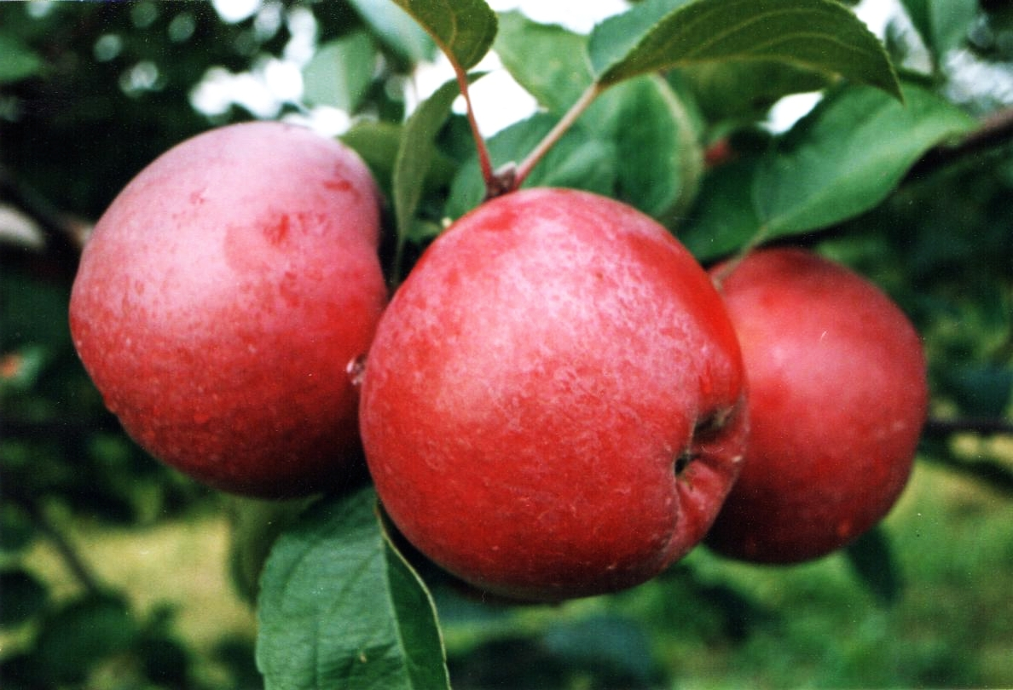
Project Ripe
Identifying and Promoting Products Ripe for Picking

Slide 2
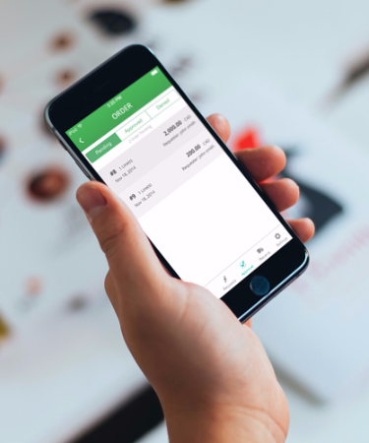
Project Ripe
Project Team
Fatima Mehdikarimi
Raj Kartha
Alejandra Gomez
Priya Kulkarni
Assam Javaid
Using machine learning to learn our customers’ preferences and promoting the right products at the right time

Slide 3
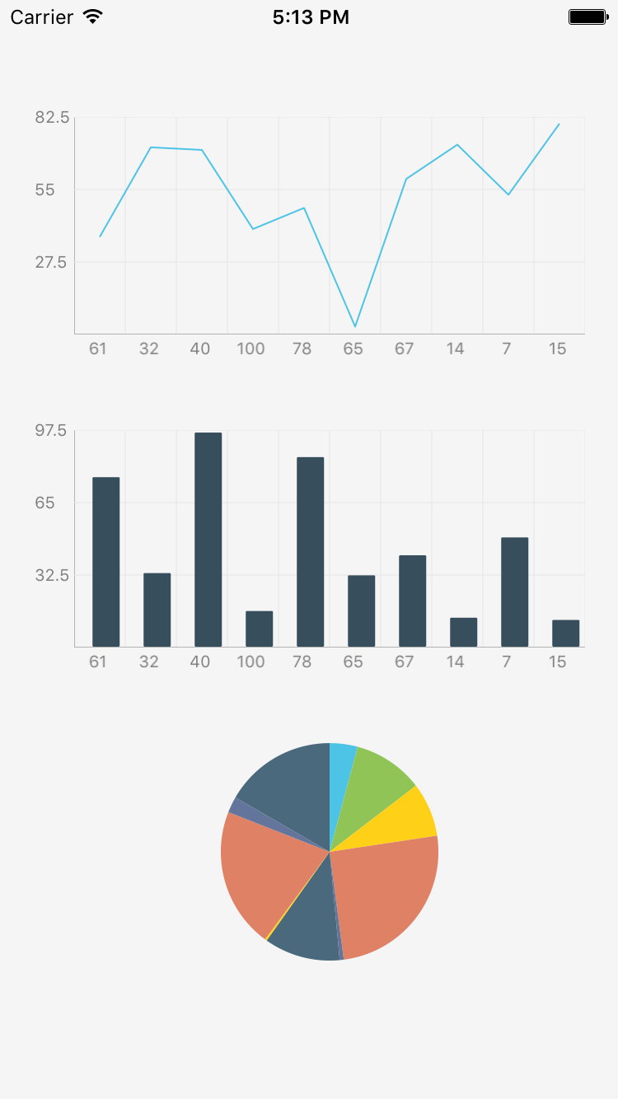
Our Data
Instacart Online Grocery Shopping Dataset
Over Three Million Grocery Orders
200,000+ Instacart users
50,000+ products
Dozens of product categories

Slide 4
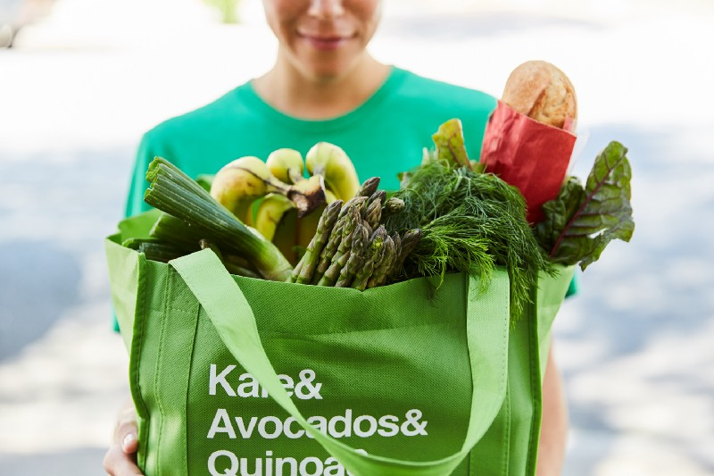
Our Learnings
Analysis of the Data

Slide 5
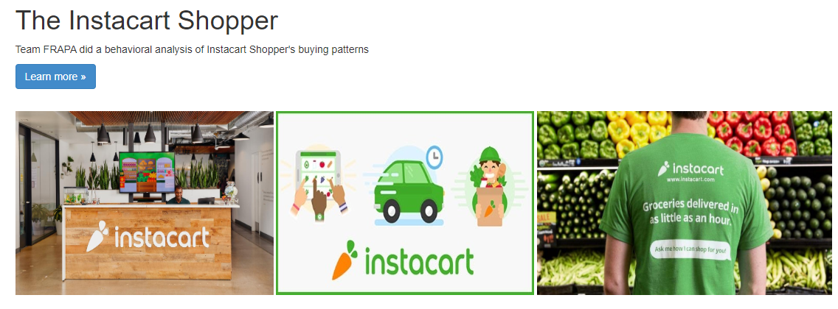
Information Hub

Slide 6

Machine Learning
Our Process & Methodology

Slide 7
Market Basket Analysis
Apriori Algorithm
What is Market Basket Analysis?
Market Basket analysis looks for the frequently co-occurring combinations of items that are bought together.
ML Library used: Mlxtend (Apriori Algorithm & Association Rules)
What are Association Rules?
Each rule is the result basket set of our Apriori Algorithm.
A rule is a group of items frequently bought together. They are the output of our model.

Slide 8
Market Basket Analysis
Apriori Algorithm
The three most popular metrics to use when evaluating Association Rules (our model results) are:
Support is an indication of how frequently the itemset appears in the dataset.
Burger (item A) → Ketchup (item B)
Support = freq (A,B) / N
Confidence is an indication of how often the rule has been found to be true.
Refers to the likelihood that Ketchup (item B) is also bought if Burger (item A) is bought.
Confidence (A ->B) = support(A,B) / support (A)
Lift indicates whether there is any relationship between Burger and Ketchup or whether the two items are occurring together in the same orders simply by chance.
Refers that the likelihood of buying Burger and Ketchup together is an x number of times more than the likelihood of just buying Burger alone.
Lift = support {A,B} / (support{A} * support{B})

Slide 9
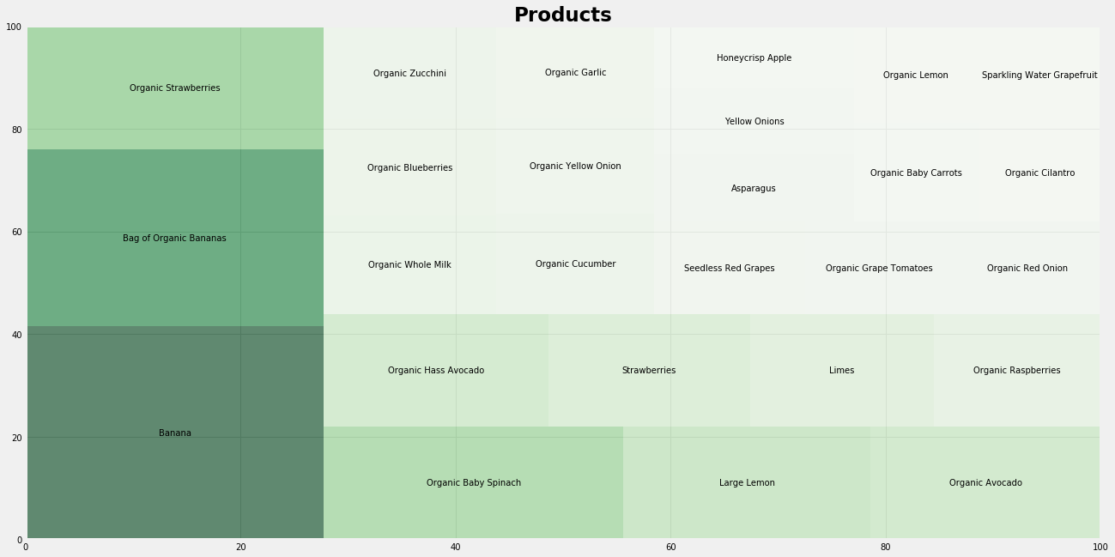
Product Data Analysis
Frequency of Top Items Ordered

Slide 10
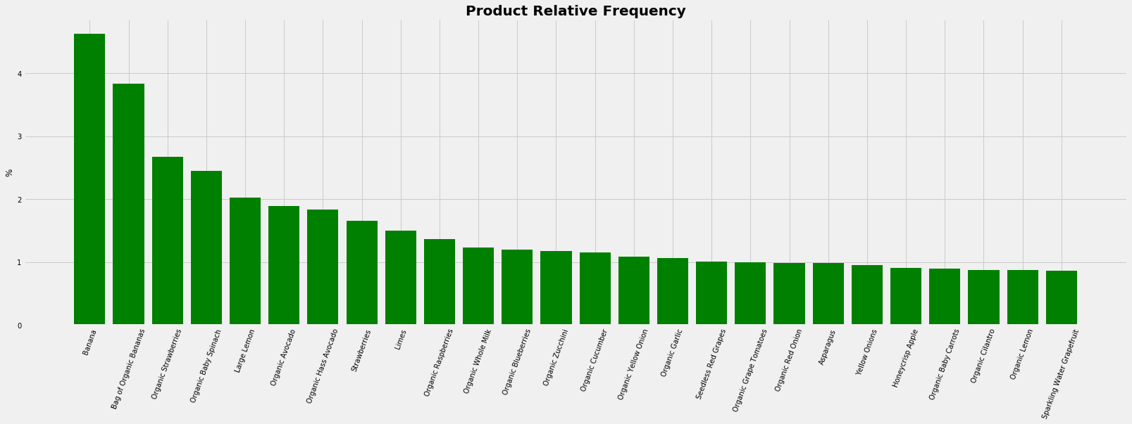
Product Data Analysis
Relative Frequency of Top Items Ordered

Slide 11
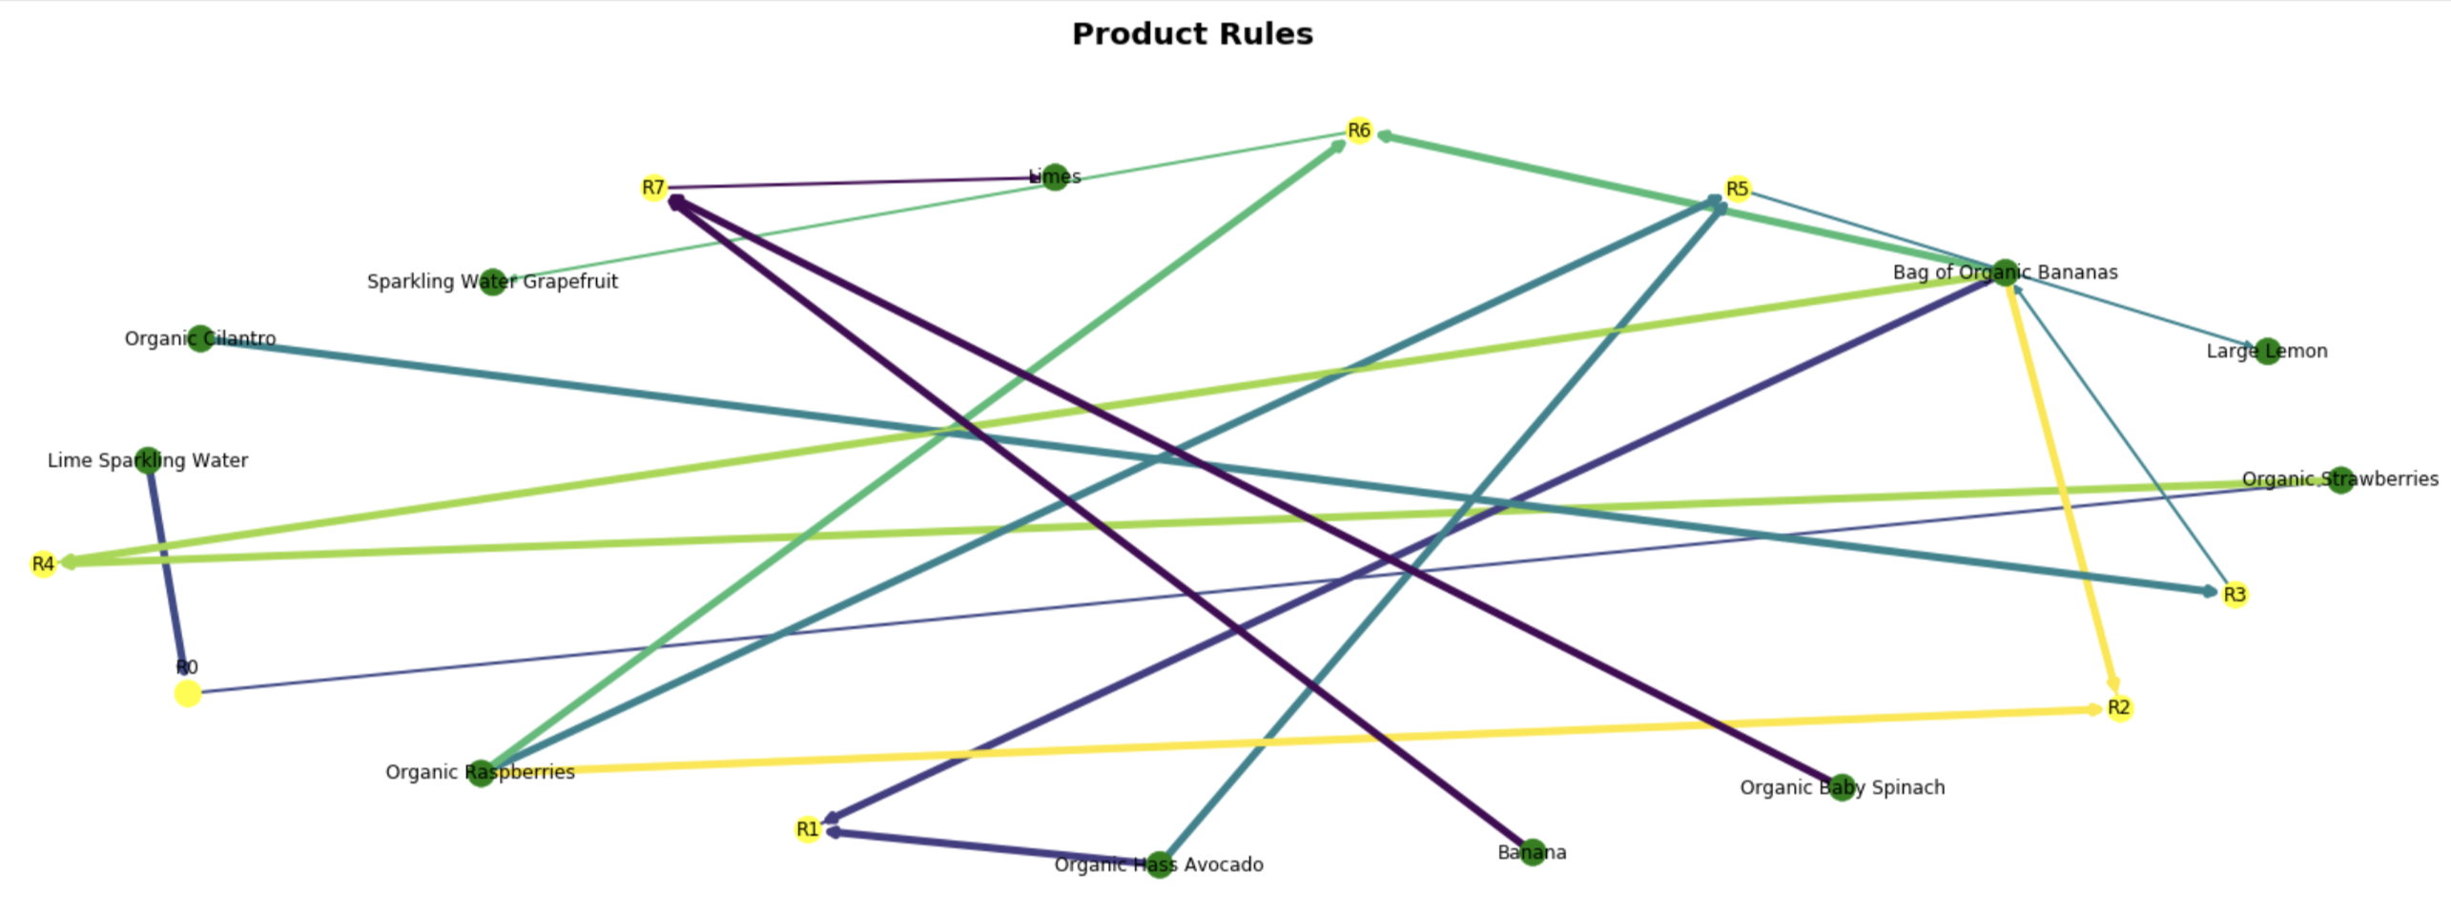
Information Hub
Association Rules

Slide 12
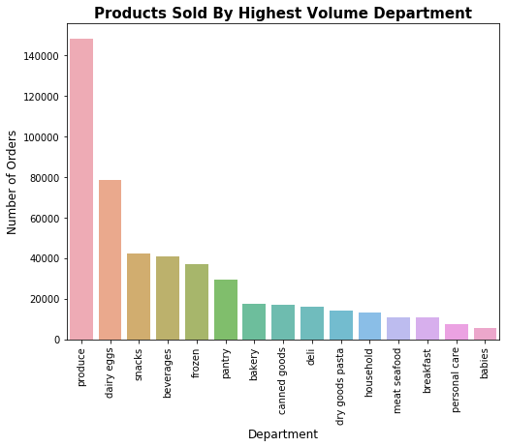
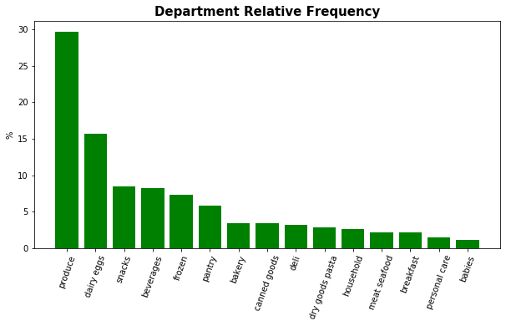
Information Hub
Department Frequency Analysis

Slide 13
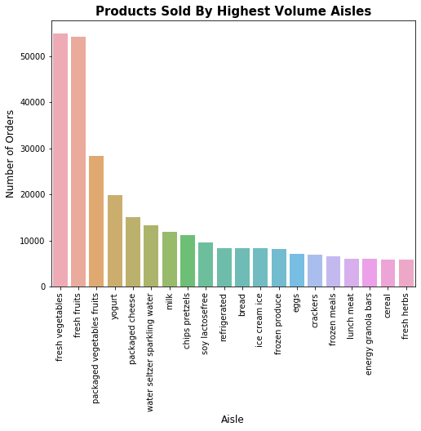
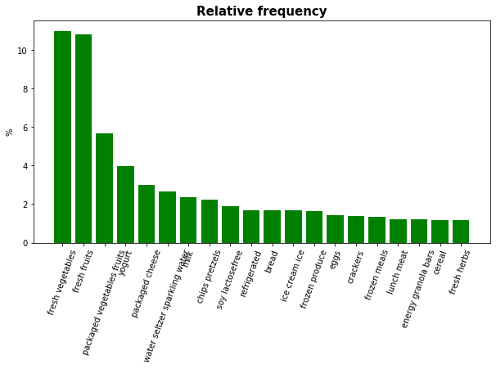
Information Hub
Aisle Frequency Analysis

Slide 14
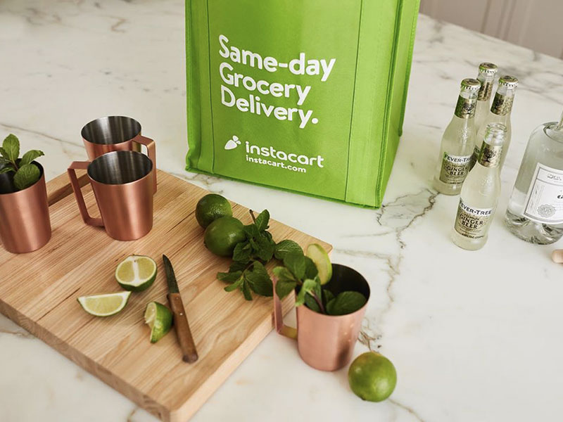
Recommendation
Our Recipe for Success

Slide 15
Increasing Basket Size
How to increase incremental order size
Promote
Don’t Forget/Reminder
Focus on Confidence
Time communications to weekends
Promote products with dark green that showcase smaller confidence levels with individualized promotions to increase sales
Organic Strawberries & Box of Organic Bananas --> Organic Raspberries
Organic Strawberries & Box of Organic Bananas --> Organic Hass Avocado
Focus on Lift
Don’t spend marketing dollars promoting products that have a yellow lift that showcase higher likelihood of being ordered
Instead place products near each other in website design and remind shoppers in cart to order
Lime Sparkling Water —> Sparkling Water Grapefruit

Slide 16

Thank You

